Slide 1
Smart home automation
Basic Architecture

Slide 2

Overall system
Hall Module
Kitchen
Module
Control unit
(using raspberry pi 4)
Bedroom module
Smart System
Module
Mobile
App

Slide 3
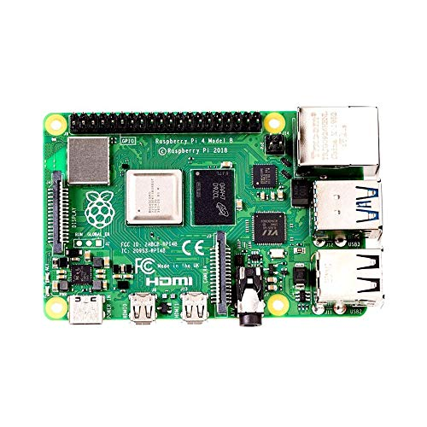
Control Unit
It is use for Hardware and software interface between system and user
It is a main controller of the project

Slide 4

Communication Tech

Slide 5
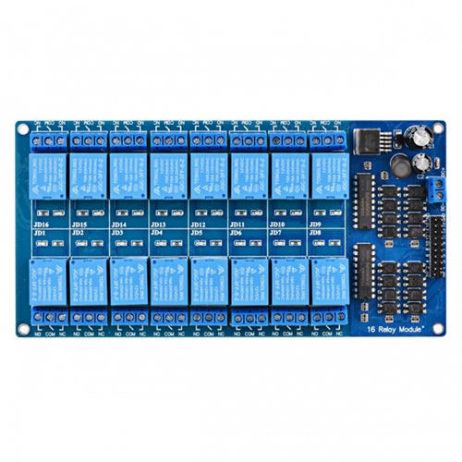
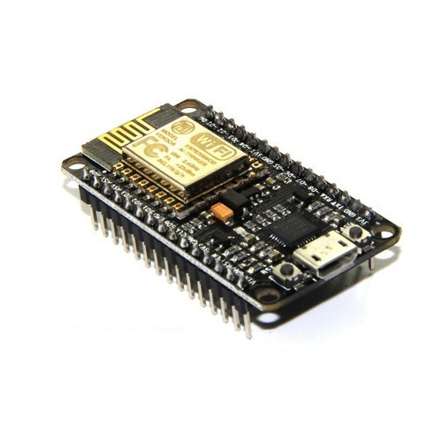
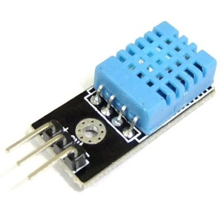
Hall Module
Hall appliances
Control Unit
Relay module

Slide 6
Kitchen Module
Control Unit
Kitchen appliances
Relay module

Slide 7
Bedroom module
Control Unit
bedroom appliances
Relay module

Slide 8
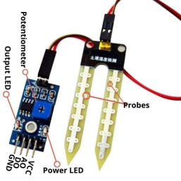
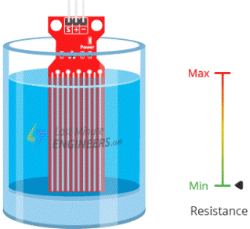
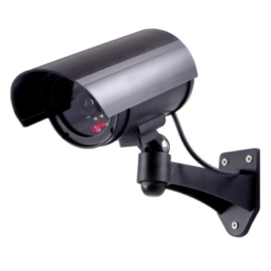
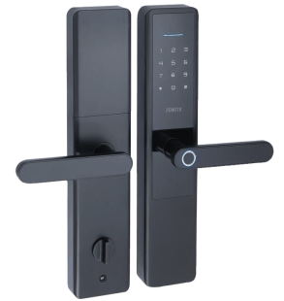
Smart System module
Control Unit

Slide 9
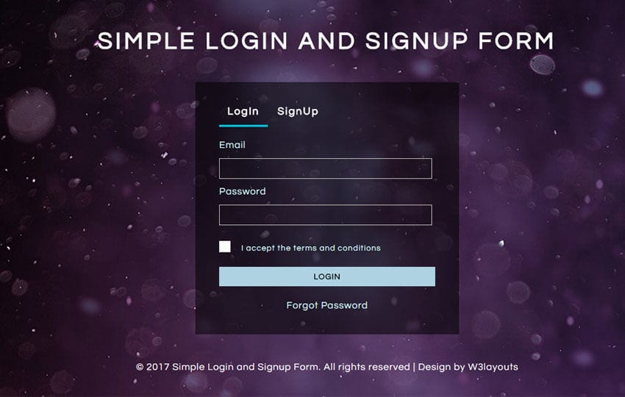
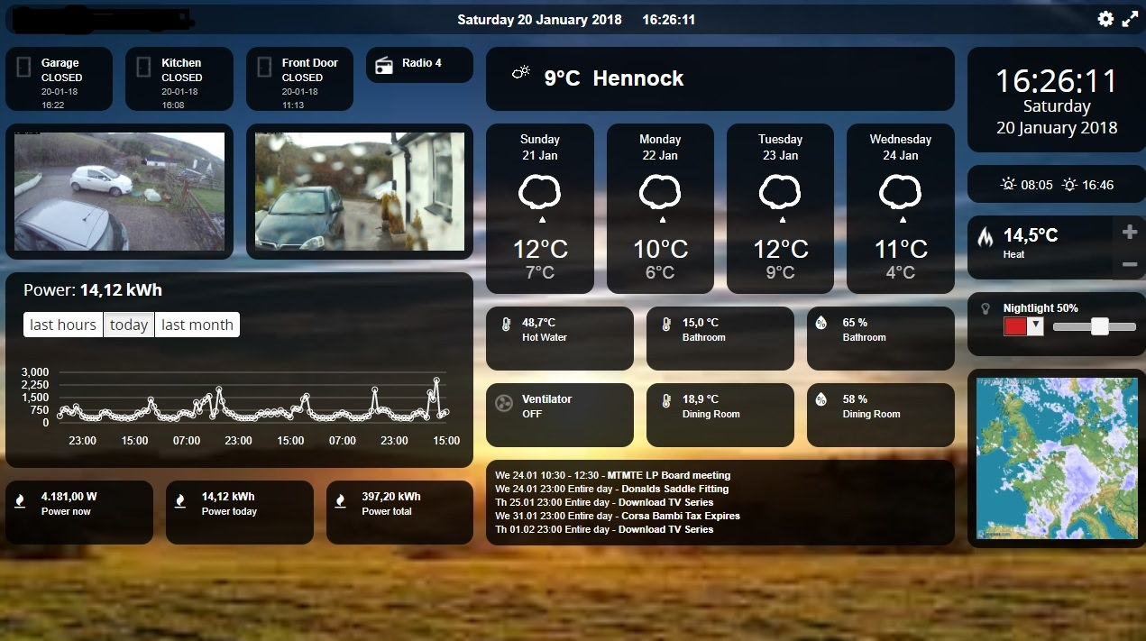
Mobile APP

Slide 10
Login and Signup

Slide 11
Dashboard

